Slide 1

VAX TRACK
Vivek Kumar | Associate Consultant | Infosys
1363410

Slide 2
AGENDA
Introduction
Application Overview
Roles & Permissions
Pages & Functionalities
Workflow Diagrams
Architecture & Database Design
Challenges & Solutions
Future Enhancements
Conclusion

Slide 3
INTRODUCTION
The COVID-19 pandemic has highlighted the critical need for efficient and accessible vaccination systems. To address this, we have developed a web-based application using the ASP.NET MVC framework. This application aims to streamline the vaccination process by providing a user-friendly portal for both normal users and administrators.
The primary purpose of this vaccination portal is to facilitate the booking and management of COVID-19 vaccination slots. The objectives include:
Simplifying the registration and booking process for users.
Providing administrators with tools to manage vaccination slots and user approvals efficiently.
Ensuring secure and accurate tracking of vaccination statuses.

Slide 4
APPLICATION OVERVIEW
The vaccination portal is designed to cater to two types of users: normal users and administrators. Normal users can register, log in, and book vaccination slots, while administrators have additional functionalities to manage the overall vaccination process. The application ensures a seamless experience.
Key Features and Functionalities
User Registration and Login: New users can register and log in to the portal. Successful registration leads to auto-login and redirection to the user profile page.
User Profile Management: Users can view and update their profile information and check their vaccination status.
Slot Booking: Users can book available vaccination slots. The status changes from ‘not vaccinated’ to ‘vaccinated’ once approved by the admin.
Admin Dashboard: Administrators have access to a dashboard displaying total users, users yet to book slots, users with pending approvals, and available slots in hospitals.
Approval and Slot Management: Admins can approve vaccination statuses and update the number of available slots in hospitals.

Slide 5

ROLES & PERMISSIONS
Tasks | User Role | Admin Role
Registration
Login
Slot Booking
Access User Profile Page
Access Dashboard Page
Approve Booked Slot
Update User’s Vaccination Status
Update Available Slots Count in Listed Hospitals

Slide 6
PAGES & FUNCTIONALITIES

Slide 7
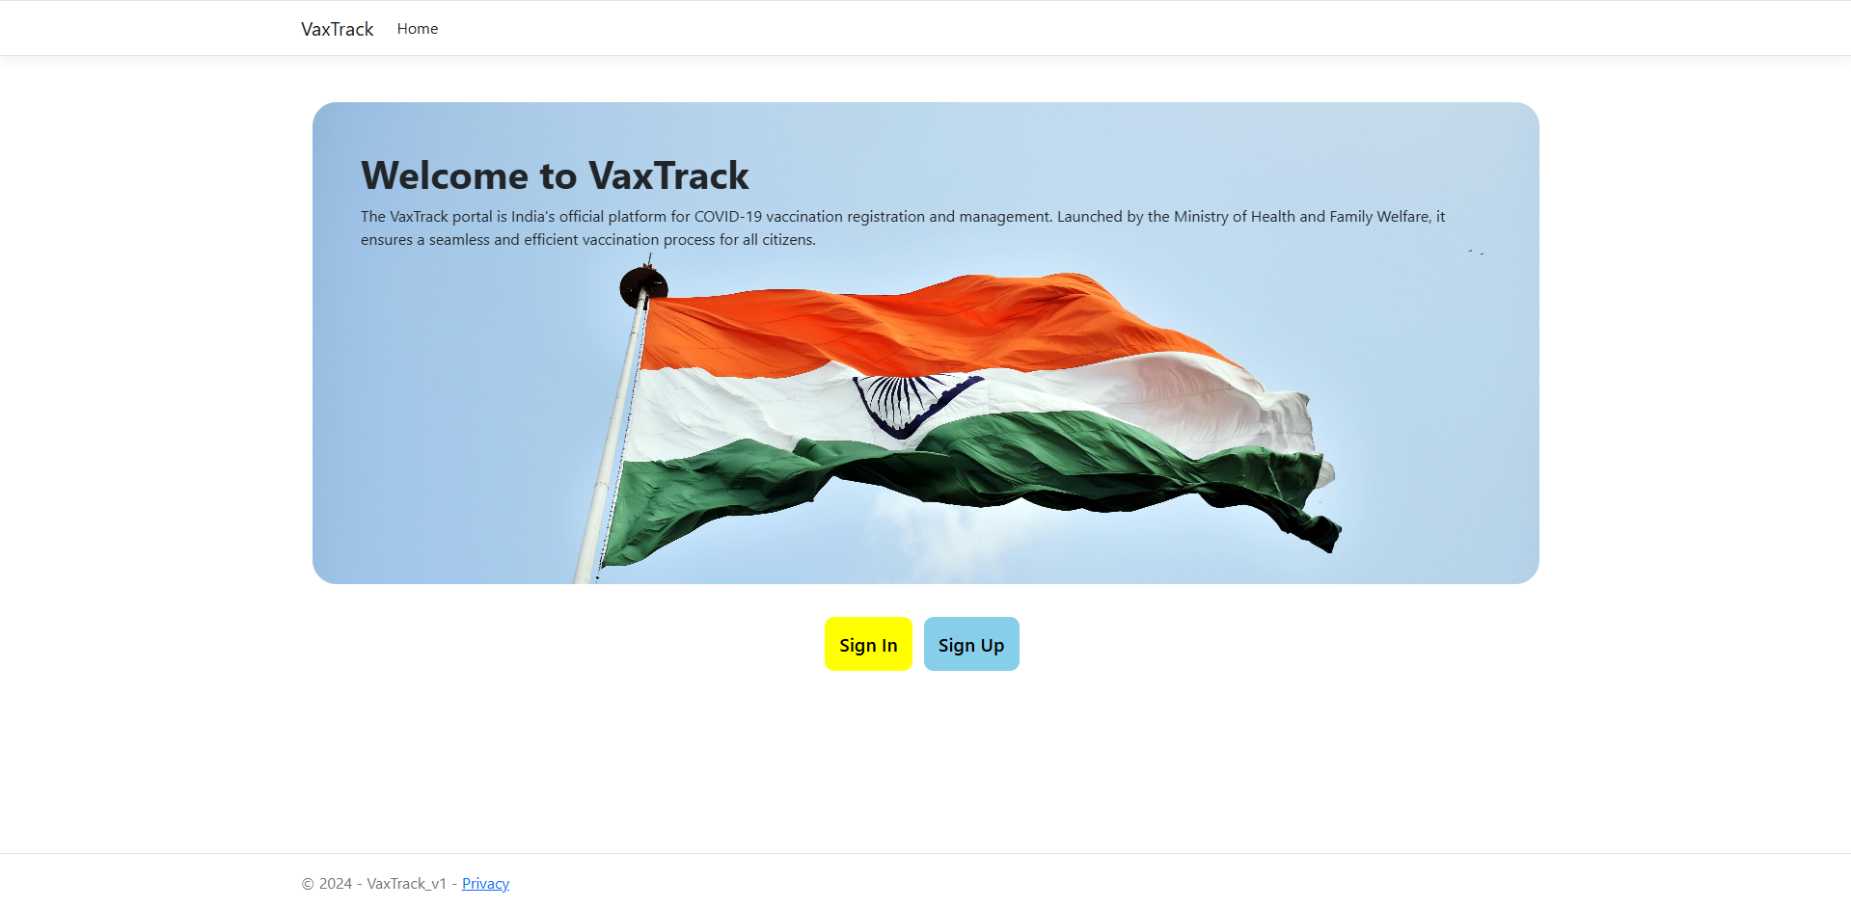
HOME PAGE

Slide 8
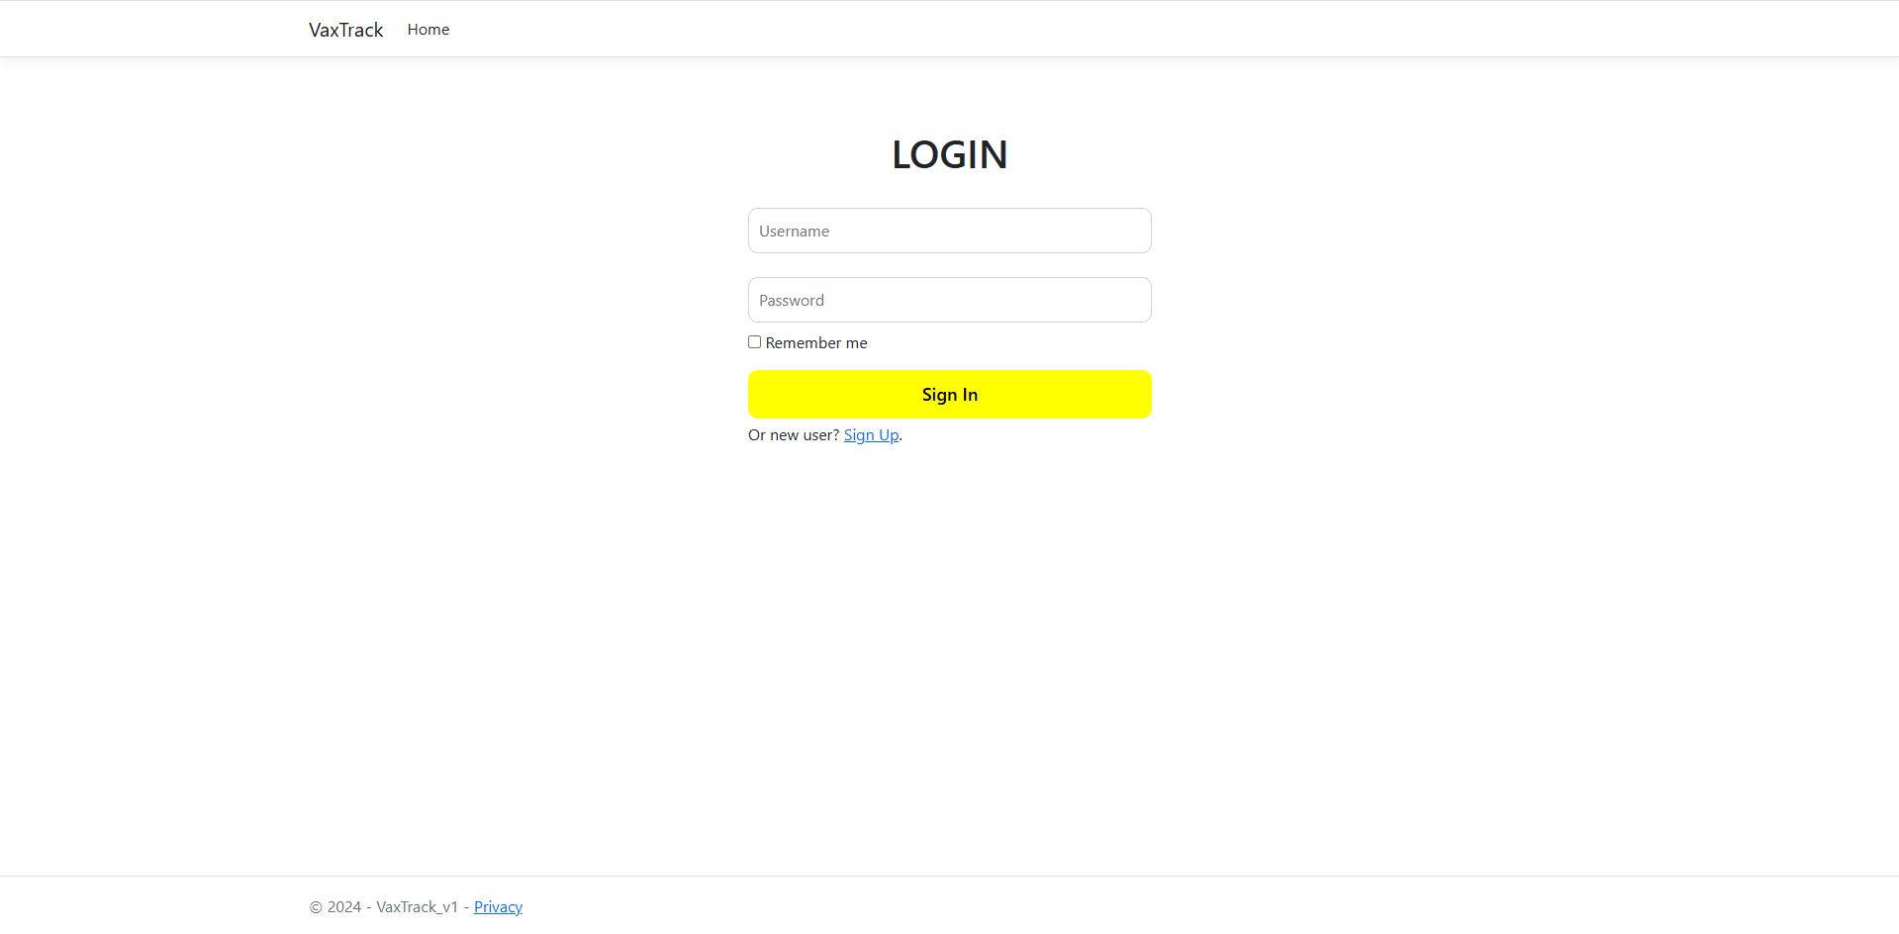
LOGIN PAGE

Slide 9
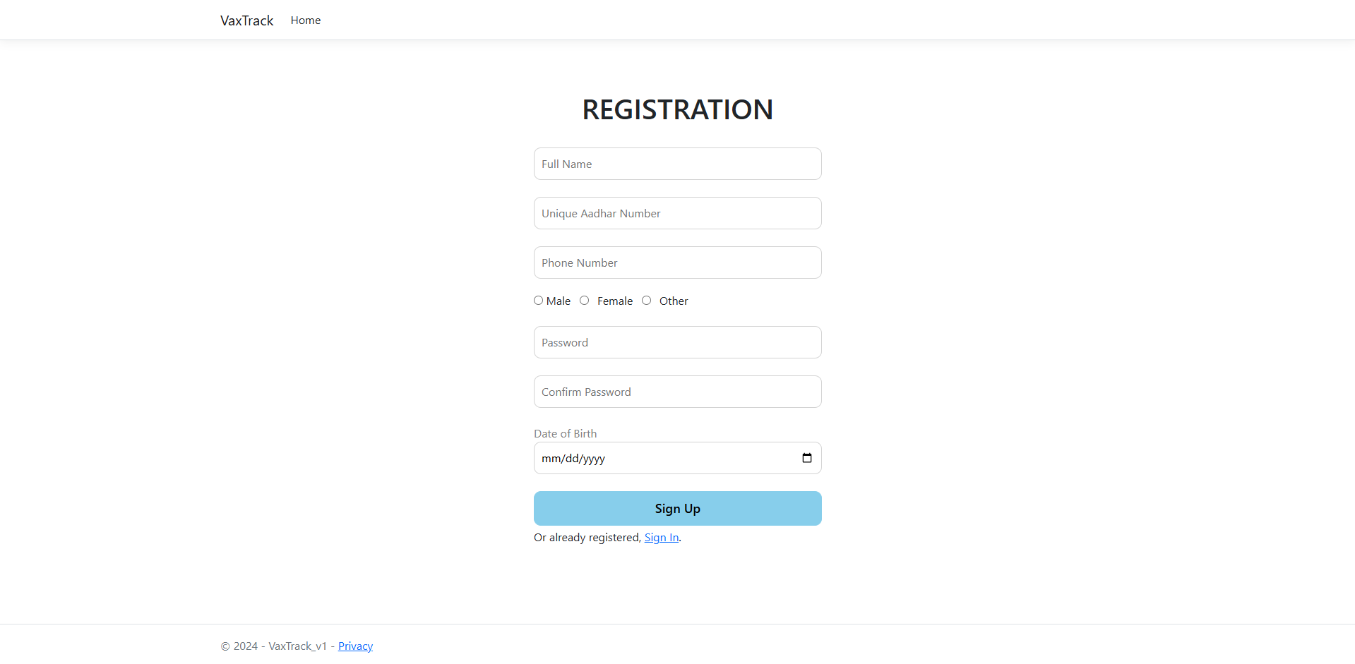
REGISTRATION PAGE

Slide 10
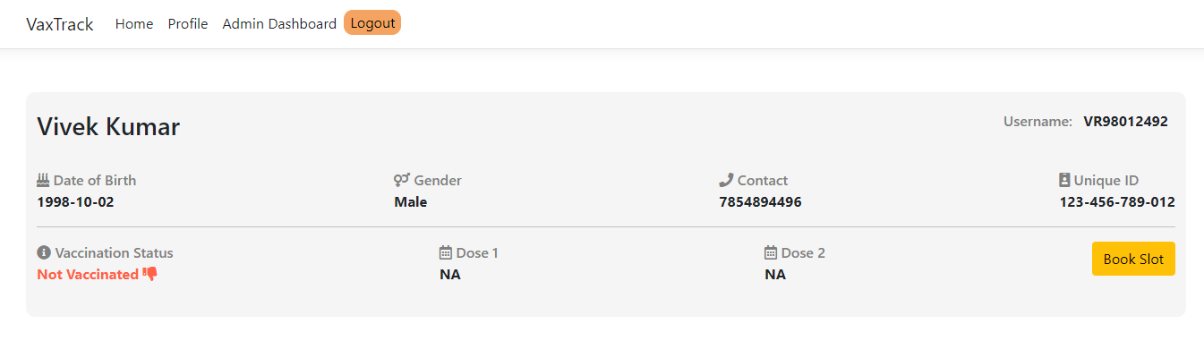
USER PROFILE PAGE

Slide 11
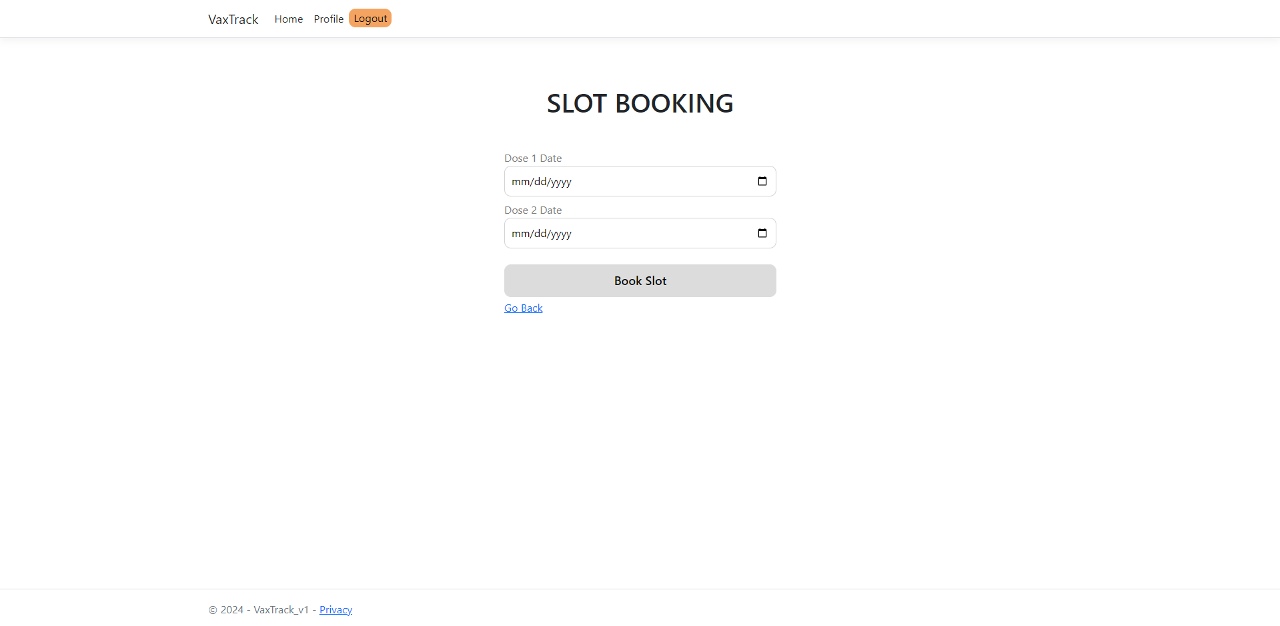
SLOT BOOKING PAGE

Slide 12
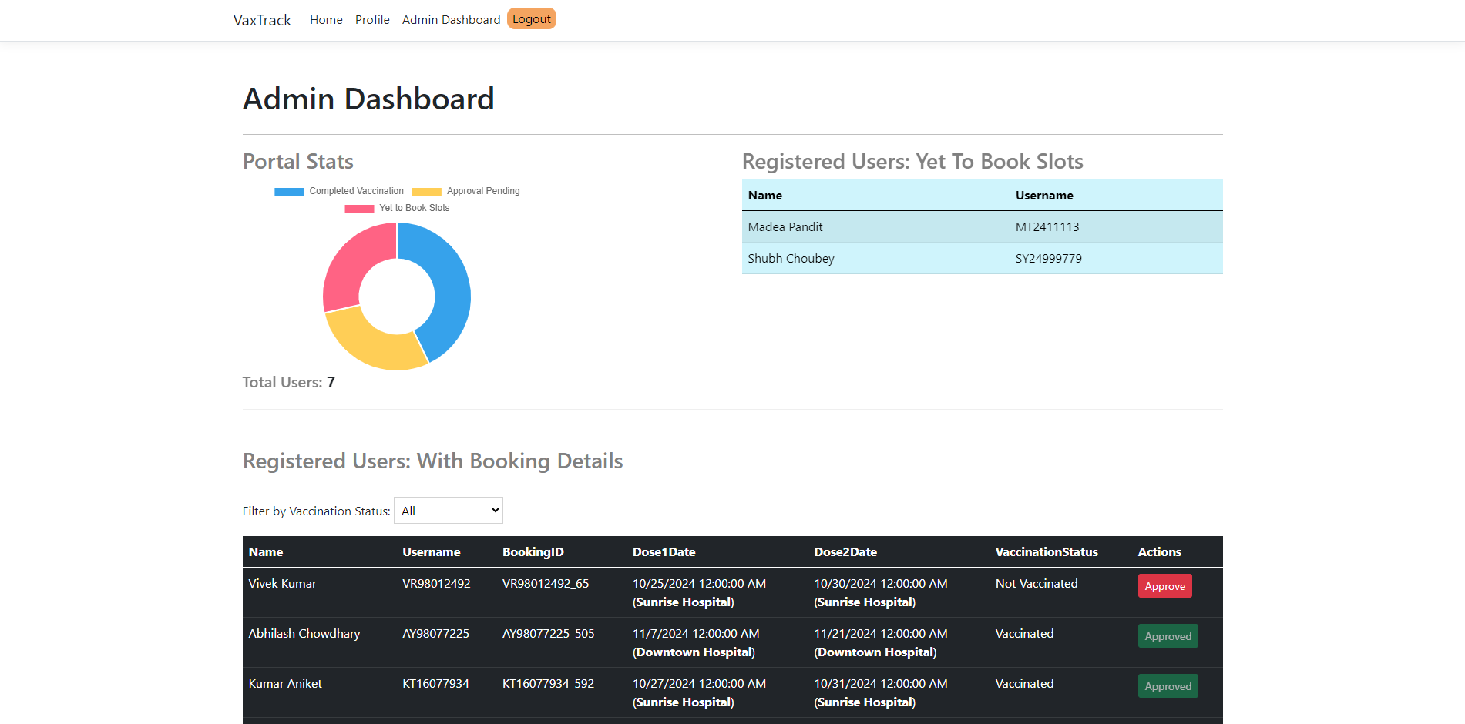
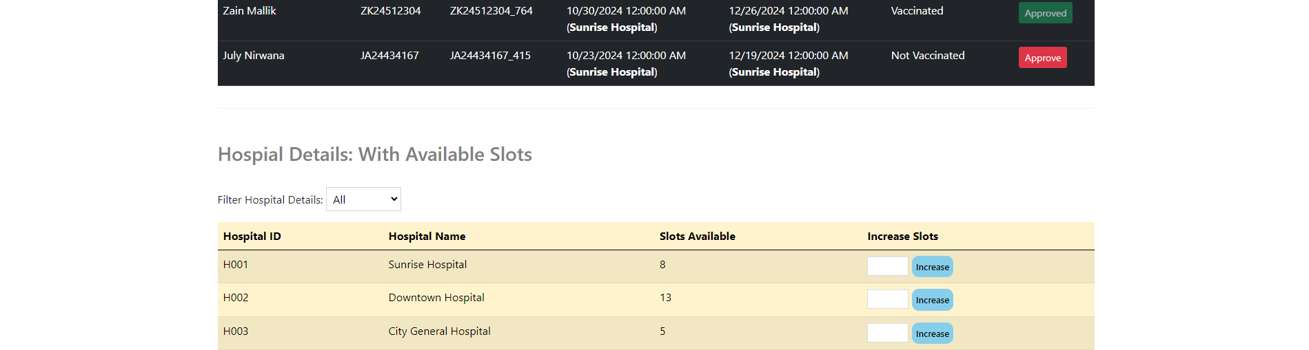
ADMIN DASHBOARD

Slide 13
USER WORKFLOW DIAGRAMS

Slide 14
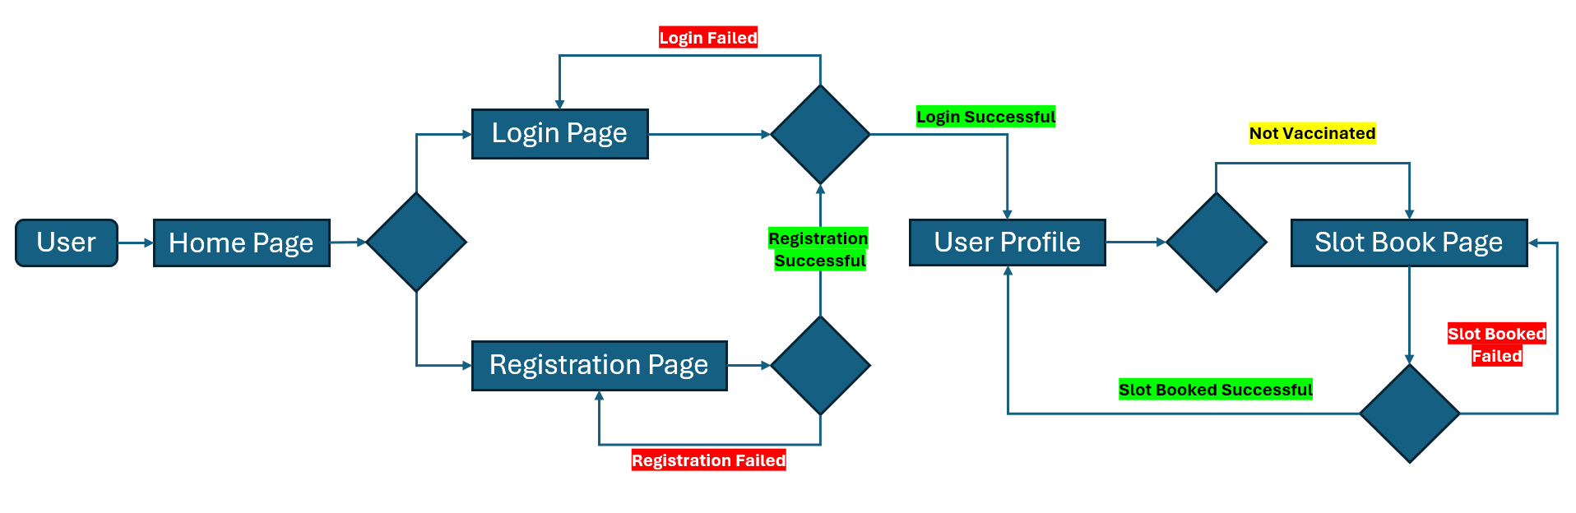
USER WORKFLOW

Slide 15
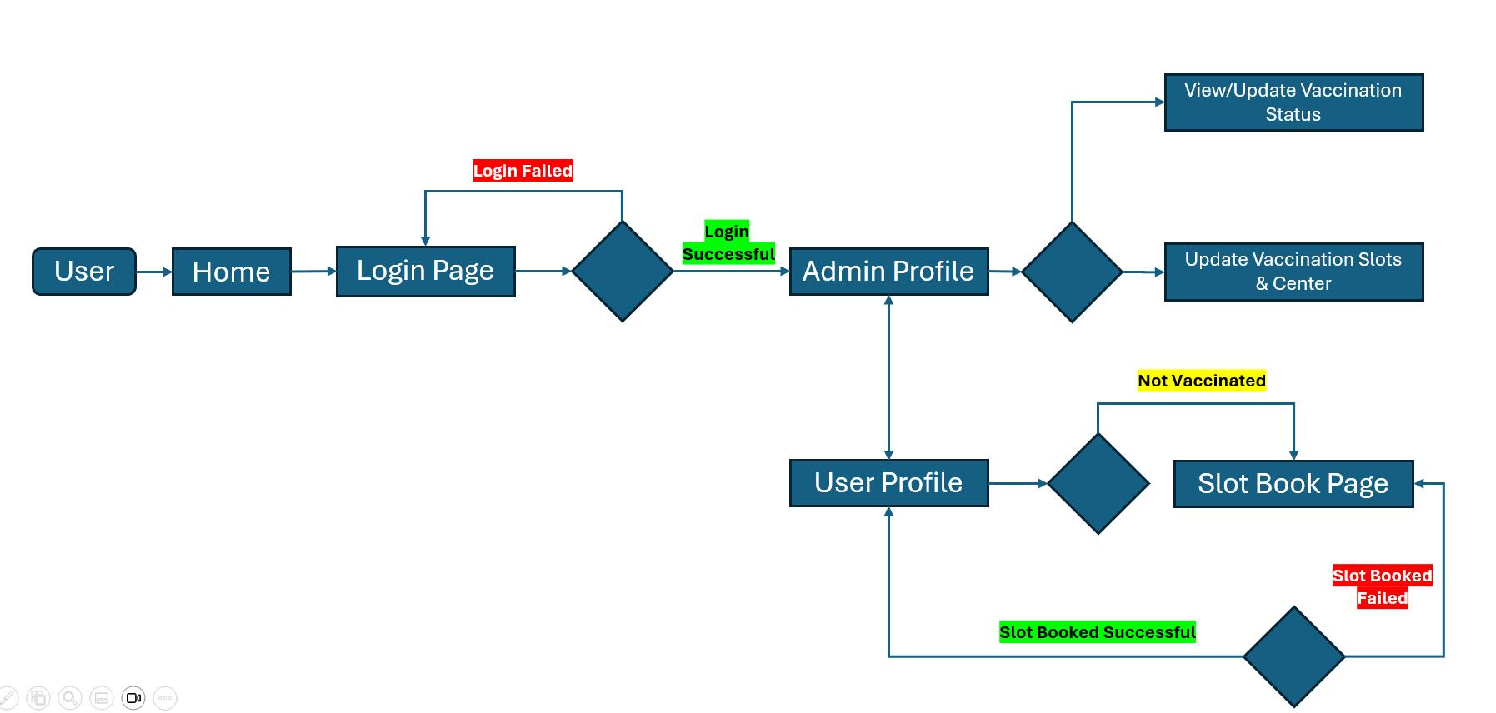
ADMIN WORKFLOW

Slide 16
ARCHITECTURE DESIGN & DATABASE DESIGN

Slide 17
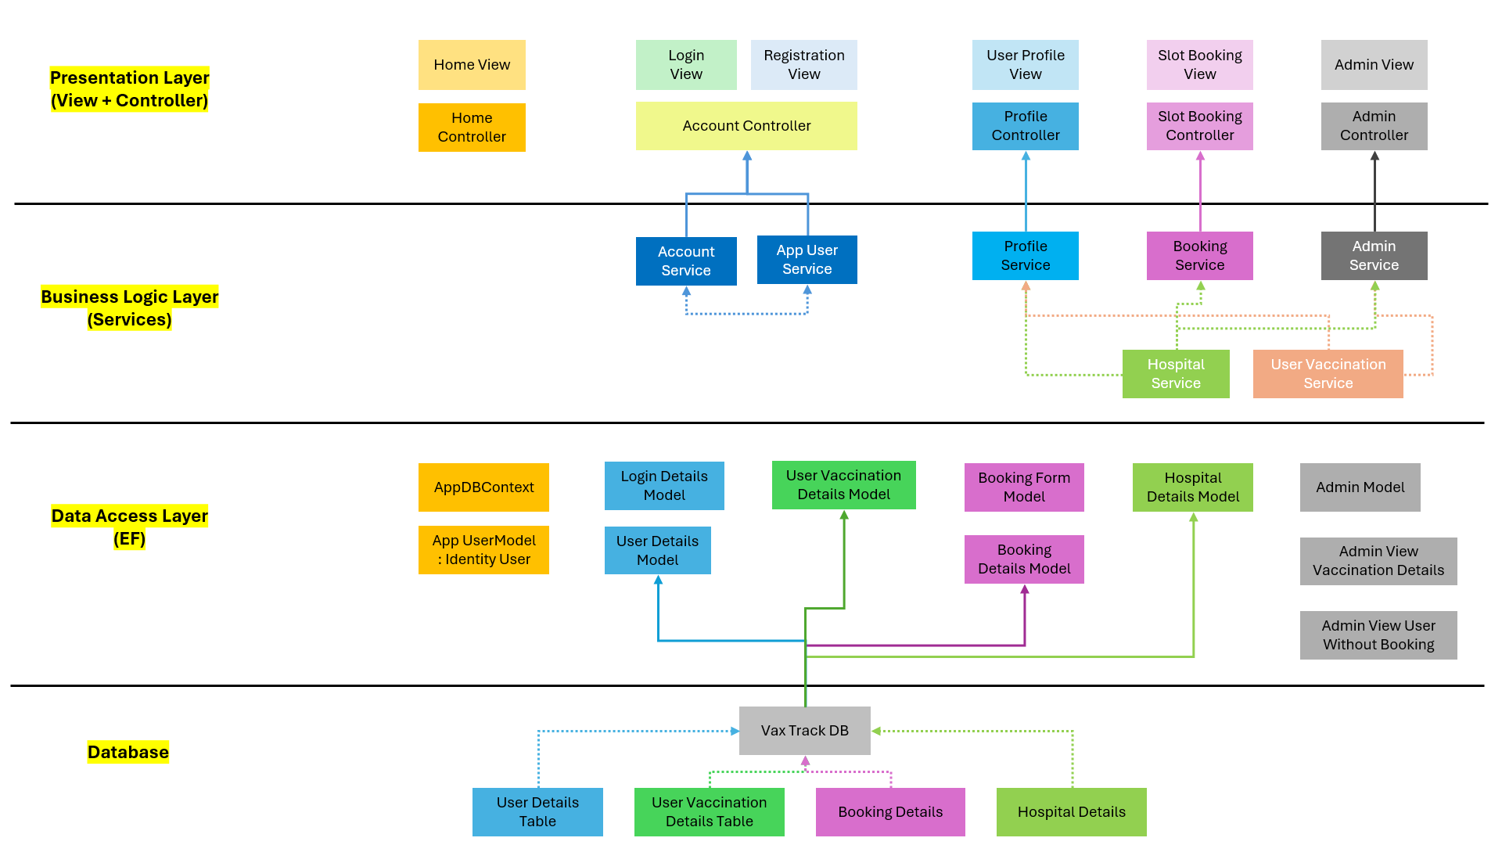
ARCHITECTURAL DESIGN

Slide 18
DB DESIGN
User Details
User Vaccination Details
Booking Details
Username : string
Password : string
Name : string
Birthdate : DateTime
Uid : string
Gender : string
Phone : string
Role : int
Username : string
VaccinationStatus : string
Dose1Date : DateTime
Dose2Date : DateTime
Username : string
BookingId : string
Dose1Date : DateTime
Dose2Date : DateTime
D1HospitalName : string
D2HospitalName : string
Slot1Num : int
Slot2Num : int
Username
Username
Hospital Details
Hospital Name
HospitalId : string
HospitalName : string
SlotsAvailable : int

Slide 19
CHALLENGES & SOLUIONS
User Authentication and Authorization:
Challenge: Implementing a secure authentication and authorization system to protect user data and restrict access to certain parts of the application.
Solution: Integrated ASP.NET Identity for managing user authentication and roles, ensuring secure access control and data protection.
Responsive Design Implementation:
Challenge: Creating a responsive and user-friendly interface using HTML, CSS, and Bootstrap that works across various devices and screen sizes.
Solution: Leveraged Bootstrap’s grid system and responsive utilities to ensure the application adapts well to different screen sizes, enhancing the user experience on both mobile and desktop devices.
Database Integration with SQLite:
Challenge: Ensuring seamless integration of SQLite with ASP.NET MVC, particularly handling database migrations and schema updates.
Solution: Utilized Entity Framework Core for SQLite, which simplified database operations and provided robust migration tools to manage schema changes efficiently.
Password Strength Label with jQuery:
Challenge: Implementing dynamic labels to indicate password strength (e.g., weak, moderate, strong, highly strong) based on user input during registration.
Solution: Utilized code from GitHub to comprehend and integrate the password strength feature into the existing registration form, ensuring a seamless user experience.

Slide 20
FUTURE ENHANCEMENTS
Admin Dashboard Page:
Enhance the dashboard by incorporating additional charts (e.g., column, bar graphs) to provide detailed insights into registered users and their booking details.
User Profile Page:
Update the user details model to include an additional string field for profile pictures, allowing users to upload their profile images.
Slot Booking Page:
Introduce a partial vaccination feature, enabling users to book a single slot initially and select the second dose slot at a later time.
Feedback & Support:
Introduce a feedback form to collect user’s concern to enhance the portal features and deliverables.

Slide 21
CONCLUSION
To wrap up, our Vax Track vaccination portal, built with the ASP.NET MVC framework, simplifies the vaccination process for users and administrators alike. It offers easy registration, slot booking, and robust admin tools for managing approvals and slot availability. This project not only meets current needs but also sets the stage for future improvements in public health management. Thank you for your time.
Thank You
Vivek Kumar | Associate Consultant | Infosys
1363410

Slide 23
Home View
Login
View
Registration
View
User Profile View
Slot Booking View
Admin View
Presentation Layer
(View + Controller)
Home Controller
Account Controller
Profile Controller
Slot Booking Controller
Admin Controller
Account Service
App User Service
Profile Service
Booking Service
Admin Service
Business Logic Layer
(Services)
Hospital Service
User Vaccination Service
AppDBContext
Login Details Model
User Vaccination Details Model
Booking Form Model
Hospital Details Model
Admin Model
Data Access Layer
(EF)
App UserModel : Identity User
User Details Model
Booking Details Model
Admin View Vaccination Details
Admin View User Without Booking
Vax Track DB
Database
User Details Table
User Vaccination Details Table
Booking Details
Hospital Details

